Slide 1


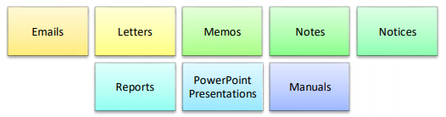
Types of Communication
Verbal communication: involves transmitting a message verbally. Ensuring the listener understands the message is crucial. Clear communication is necessary to avoid misunderstandings. Examples of verbal communication:
Non-Verbal Communication: does not use any words to convey the message. It uses gestures, posture, body language, expressions and tone of voice for communicating. Examples of non-verbal communication:
Written communication: uses written language, signs or symbols for communicating. The message is influenced by the vocabulary, grammar, writing style, precision and clarity of the language used. Examples of written communication:

Slide 2
Barriers to Effective Communication
Physical barriers- When two persons are not present at the same physical location
Perceptual barriers- When two people have a different perception of the same thing
Emotional barriers- For somebody, discussing personal issues in the office may be okay, while another person could consider that as unacceptable.
Cultural barriers- In some cultures shaking hands with female colleagues is acceptable, while in the others, it may be unacceptable.
Language barriers- When two people communicating, do not know the same language, miscommunication can happen.

Slide 3
How to Communicate Effectively at Work
Be clear about what you want to say before communicating.
Modify your message according to the recipient, if required.
Be careful about the language, tone and content of the message.
Take cues from the non-verbal messages of the receiver.
The message being sent out should be consistent and not self-contradictory.
Listen to the other person’s point of view during a communication.
Follow-up after the communication to ensure the message has gone across.
Do not let your personal biases creep in.

Slide 4
Email Etiquettes
Subject line that is crisp and clear and matches the content
Use official email address/account to conduct all official messaging.
Make your message easy to read. Don’t use long sentences. Use bullets points.
Keep it short and get to the point. Write concisely, with lots of white space, so as to not overwhelm the recipient.
Tailor your message depending on the receiver's cultural background or how well you know them.
It's better to leave humour out of emails unless you know the recipient well. Something that you think is funny might not be funny to someone else.
Proofread every message. Don't rely only on spell-checkers.
Be cautious with all capitals in the message. It may be perceived the wrong way.
Always include a signature.

Slide 5
Work with colleagues to integrate their work effectively
Define the Goal and Scope: Clearly define the desired outcome of the combined work and what each part contributes
Understand Individual Roles and Work: Conduct individual meetings/group call to understand each colleague's specific tasks, timelines, and goals.
Establish Communication Channels and Frequency: Choose comfortable communication tools (chat group/regular meetings) and agree on a frequency for feedback and updates.
Identify Integration Points and Dependencies
Collaborate and Provide Feedback: Encourage open communication, provide constructive feedback, be receptive to suggestions. Leverage technology to make collaboration seamless and transparent allowing everyone to work on the same page.
Celebrate Success and Learn from Experiences: Acknowledge everyone's contribution and reflect on the collaboration process, identify what worked well and areas for improvement.

Slide 6
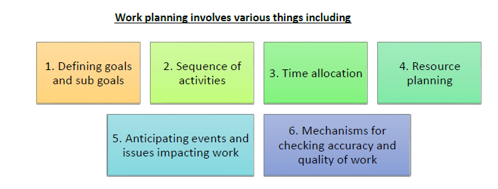
Organizations policies and procedures
Why do companies have policies and procedures?
Ease of working and common understanding
Optimizing performance and productivity
Reduction of errors, safety and security
Reliability and trustworthiness
To remain compliant with legal, regulatory and statutory requirements
Planning work and work environment

Slide 7
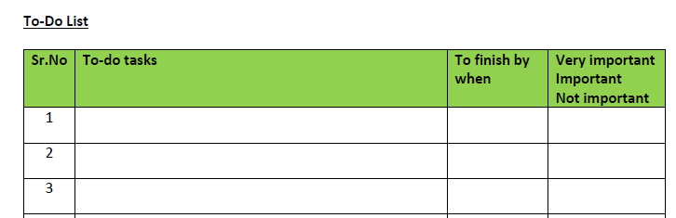
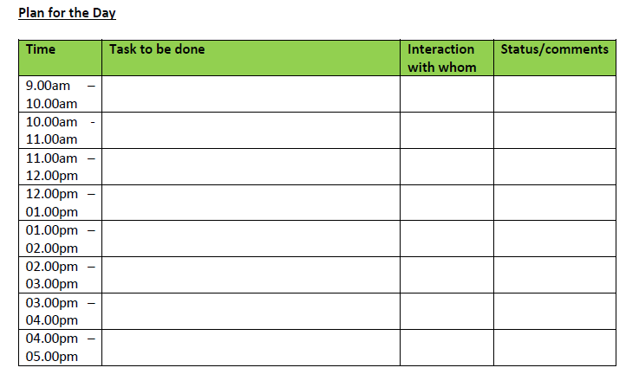
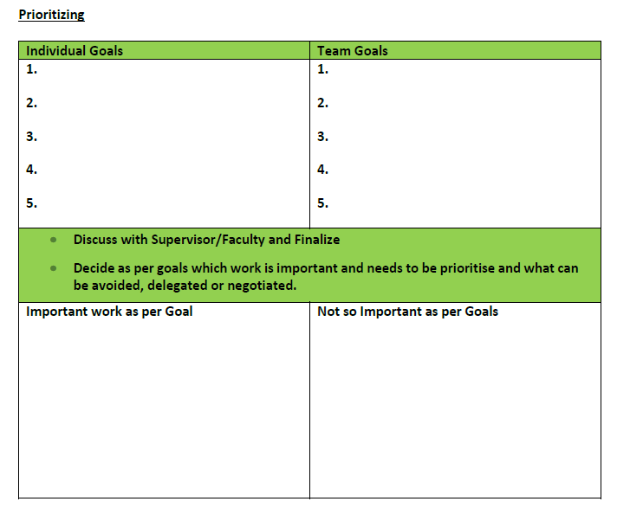
Planning work and work environment

